Slide 1
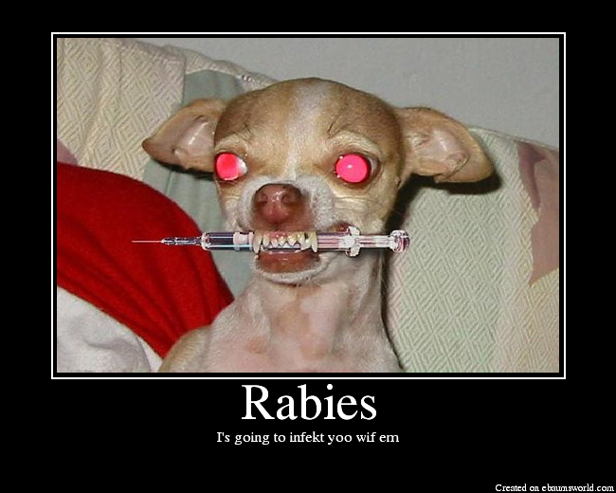

Lecture 10
RNA viruses
Neg sense ssRNA

Slide 2
Neg sense RNA viruses
Overview
• Negative sense RNA viruses
- Defined by their genome resembling the complement of
mRNA
- Genome cannot be translated by ribosomes
- Genome is non-infectious (if inserted into cells)
- Must package their own RdRp into the virion itself
- Mostly infect animals
- Subdivided into those that have single pieces of nucleic
acid (monopartite) and those that have many (segmented
or multipartite)

Slide 3
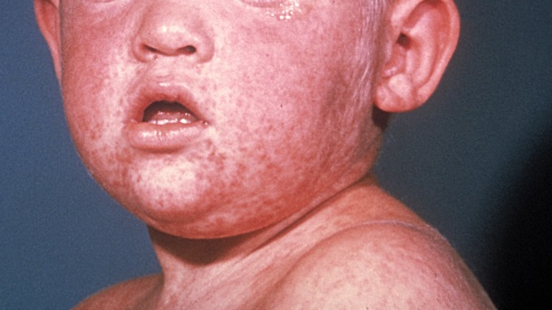
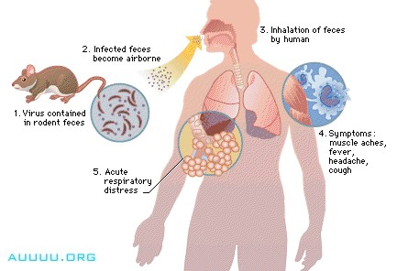
Neg sense RNA viruses
Major families
• Many types of negative sense RNA viruses cause serious
human disease
- Those with monopartite genomes
- Rhabdoviridae – Rabies
- Filoviridae – Ebola, Marburg
(hemorrhagic diseases)
- Paramyxoviridae – Measles, mumps, RSV
- Bornaviridae – Borna disease
- Those with segmented genomes
- Orthomyxoviridae – influenza viruses
- Bunyaviridae – Hantavirus
- Arenaviridae – Lassa fever virus

Slide 4
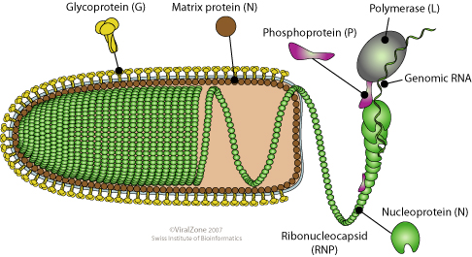
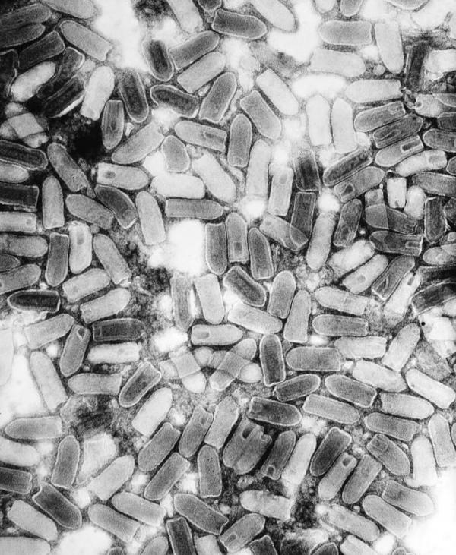
Rhabdoviruses
Overview
• Family of viruses that have enveloped, bullet shaped helical
capsids (rhabdos = rod in Greek)
- Genome is single piece of negative sense RNA
• Infect a wide variety of animals and plant species
- Most common human pathogens – VSV and rabies
• Unique features of the matrix (M) protein
- Inhibits transcription by all host RNA pol
- Blocks protein and RNA movement in/out of
the nucleus
- Nuclear function completely gone
- Inhibits interferon action

Slide 5
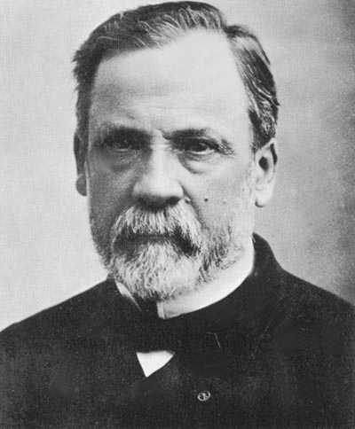
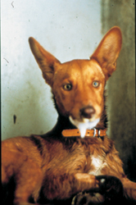
Rhabdoviruses
Rabies
• Causes a fatal encephalitis in nearly 100% of those infected
- Still kills 10,000-50,000 a year (developing countries)
- Only 6 people ever have survived after start of symptoms
• Early symptoms (1-3 months post infection)
- Fever, muscle and headache, nausea, and
twitching/tingling at the site of infection
• Later symptoms (2 months – years)
- Encephalitis, confusion, seizures, hallucinations, and
sensitivity to light, sound, touch, etc.
- Body temp rises and increased salivation → Frothing
- Throat spasms when swallowing water → Hydrophobia
- Coma occurs and death soon after

Slide 6


Rhabdoviruses
Rabies
• Rabies is primarily acquired from the saliva of an infected
animal following a bite/abrasion
- Dogs and cats (domestic), bats, raccoons, foxes, and
skunks
- Can't eliminate, but can control by vaccinating animals
- Also contracted by inhaling infected animal feces (bats)
• Once infected, animals exhibit similar symptoms as humans
- See two major forms of animal rabies:
1) Excitable form - Become irritable and aggressive
- Prone to attack other animals, people,
or inanimate objects
2) "Dumb" form - Become listless, stop
eating, throat closes → death

Slide 7
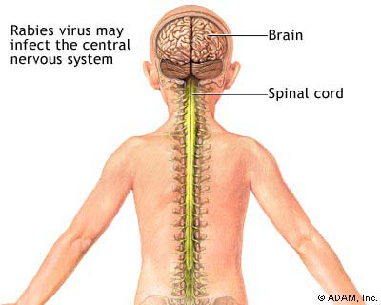
Rhabdoviruses
Rabies
• Spread to CNS and back again
- Length of time before spread to CNS depends on inoculum
size and location of the bite
- More virus and closer to head → Quicker death
- Mechanism and triggers of spread – not really known
- Virus binds to peripheral neuron axon terminus and
enters cytosol – uses NAR to attach
- Capsid moves from periphery to CNS in cytosol
- Replicates very well in many different cell types of brain and
spinal cord
- High numbers of viruses go back into peripheral neurons
- Spread to almost every tissue in the body
- Spread is most efficient to salivary glands, eyes,…

Slide 8
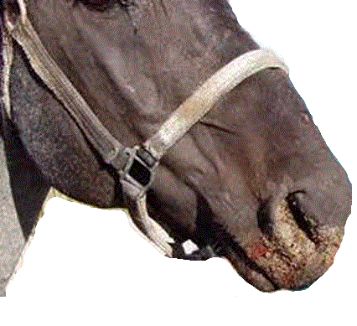
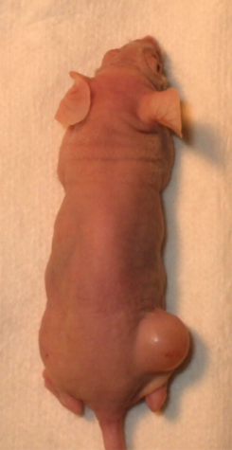
Rhabdoviruses
Vesicular stomatitis virus (VSV)
• VSV disease
- Produces vesicular lesions on the mouth of
livestock and humans
- Livestock will stop eating during acute
phase → dangerous if animal not cared for
- Self-limiting and low mortality
• Type of oncolytic virus
- Naturally have a tendency to kill tumor
cells more effectively than normal cells
- Not only will they kill the tumor cells, but
also spark an immune response (allowing
animal to begin fighting its own tumor)

Slide 9
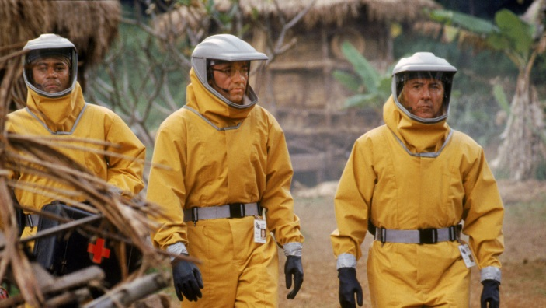

Filoviruses
Discovery
• Discovery and major types
- 1967 (Marburg, Germany) – Lab workers handling African
Green Monkey tissue from Uganda became ill w/
hemorrhagic disease
- 7 died and they passed it onto other hospital workers
- New virus discovered = Marburg virus
- 1976 (Zaire and Sudan) – Outbreak of similar
hemorrhagic disease w/ extremely high
mortality (~90%)
- Named Ebola virus
- Outbreaks occur every several years
and are extremely serious threats

Slide 10

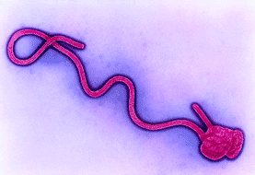
Filoviruses
Ebola and Marburg
• Enveloped viruses with a long, thread-like helical capsids
- Filum = thread in Latin
• Major features of filoviruses
- Cause hemorrhagic disease
- Can infect variety of animals, including
primates, pigs, and bats
- Enter and leave human population on a regular basis
- Must have animal reservoir(s)
- Probably fruit bats
- Spread between humans by blood and other body fluids
- Not respiratory, STI?
- Contagious virions – very little contact can lead to infection

Slide 11
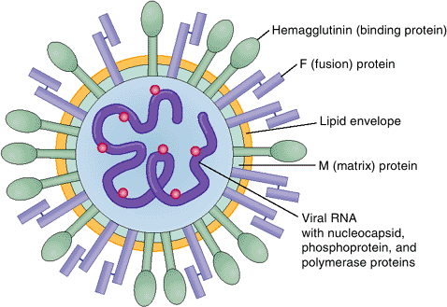
Paramyxoviruses
Overview
• Enveloped virions w/ single piece
of neg sense ssRNA
- Helical capsid, but overall shape
is pleomorphic
• They are named due to their
propensity to trigger mucous production in the sick
- Myxo = mucous
• Includes a number of serious human and animal pathogens
- Measles, mumps, RSV, canine distemper, rinderpest,
and parainfluenza virus

Slide 12
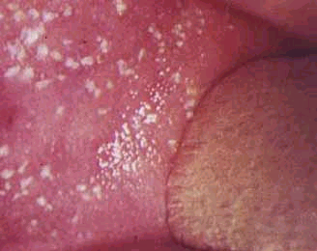
Paramyxoviruses
Measles
• Measles disease symptoms
- About 1-2 weeks post-infection, usually have a
high fever, cough, conjunctivitis, widespread rash,
and characteristic Koplik spots
- Koplik spots – Raised white spot surrounded by a
irregular bright redness
- Severe immunosuppression typically occurs
- See lots of 2° bacterial infections and reactivation of TB
and HSV
- Some also develop encephalitis quickly (AME) or a few
years later (SSPE)
- SSPE is very severe and nearly 100% fatal

Slide 13
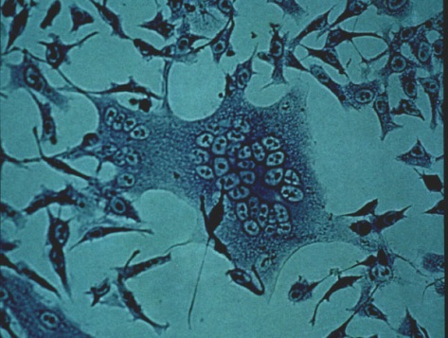
Paramyxoviruses
Measles
• Spread of the measles virus
- Most commonly transmitted by inhalation of respiratory
droplets
- Very contagious – can be from brief encounter
- Usually transmitted before symptoms appear
- Can also be acquired from eye exposure to respiratory
droplets
- Initial site of replication would then be in eye epithelium
• Interesting aspects of its replication
- Very lytic (kills infected cells efficiently), induces inflamm.
- Induces syncytia formation
- F protein on infected cells fuses w/ uninfected

Slide 14

Paramyxoviruses
Measles
• Treatment, prevention, outcomes
- Usually self-limiting and requires no intervention
- Immunosuppressed, “new” populations, and children
who are malnourished are susceptible to complications
(and death)
- Vitamin A deficiency major risk factor
- Watch for 2° infections, pneumonia, diarrhea, and
encephalitis
- Give vit A and treat symptoms → No direct treatment!
- Live, attenuated (MMR) vaccine very effective at prevention

Slide 15
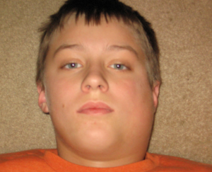
Paramyxoviruses
Other viruses/diseases
• Mumps
- Relatively minor, self-limiting childhood disease
characterized by fever and swollen salivary (parotid) glands
- Complications can arise, especially for teens/adults
- Gonadal tissue can be targeted → pain and permanent
reproductive damage
- Encephalitis and meningitis in some cases
• Respiratory syncytial virus (RSV)
- Common in adults → chronic, minor upper respiratory
infections (especially during dry winter)
- Almost part of normal flora in many
- Can lead to pneumonia, respiratory failure, & death in
premature newborns and those w/ lung problems

Slide 16
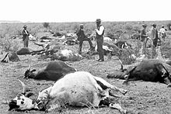
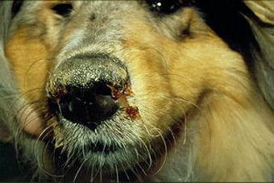
Paramyxoviruses
Other viruses/diseases
• Canine distemper and rinderpest
- Distemper
- Caused by a virus (CDV) similar to human measles virus
- Affects dogs and many other domestic
and wild animals (e.g. raccoons, foxes,…)
- Deadly disease characterized by fever, nasal/eye
discharge, poor breathing, hardened nose/foot pads, and
severe neurological symptoms (e.g. seizures, spasms)
- Rinderpest
- Disease of livestock and ungulates similar to distemper,
but even more deadly (nearly 100%)
- Mass vaccinations in 20th century → eradicated 2010!

Slide 17
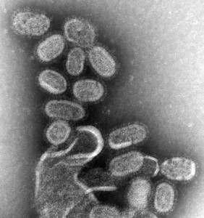
Orthomyxoviruses
Overview
• Structural characteristics
- Segmented RNA genome – 7-8 pieces
- Genome encapsulated by a NP protein (nucleoprotein)
- Several helical capsids (1 for each segment)
- Nucleocapsid(s) surrounded by a layer of matrix protein and
host-derived envelope
• Influenza viruses are most important type that affects humans
- Causes fever, muscle ache, and major respiratory illness
- Deadly for very young and old (pneumonia)
- Three major epidemics
- 1918 – H1N1 strain (Spanish flu) killed over 50 million
- 1957 – H2N2 strain (Asian flu) – 1.5 million died
- 1968 – H3N2 strain (Hong Kong flu) – 750,000 died

Slide 18
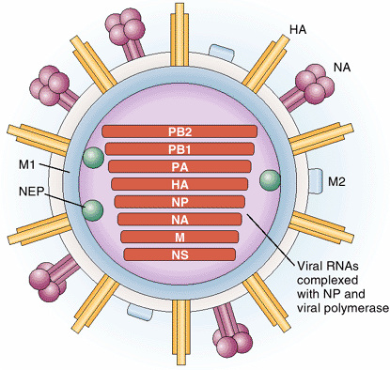
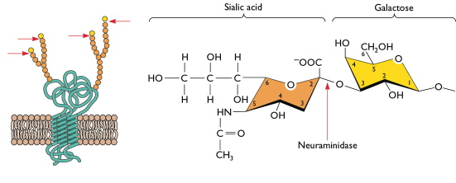
Orthomyxoviruses
Influenza viruses
• Host-virion attachment
- Virions bind to terminal sialic acid residues
linked to galactose found in host
glycoproteins (respir. epithelial cells)
- SA-gal linkage is important
- Humans have α(2,6), birds α(2,3), pigs have both
- Flu hemagglutinin (HA)
on its surface attaches
to host SA during entry
- Flu neuraminidase (NA) cuts SA during exit
→ Must have HA & NA that can bind to same SA-gal linkage

Slide 19
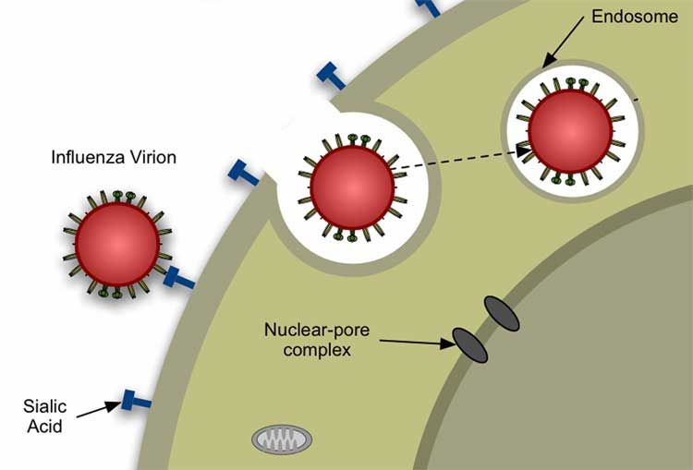
Orthomyxoviruses
Influenza viruses
• Unique aspects of its replication
- Entry/uncoating
- Virions are internalized into endosomes
- Acidification occurs
- Virion has a channel protein called M2
in its envelope that allows H⁺ to enter
into the viral core → triggers full uncoating
- Some flu drugs (amantidine/rimantidine) target M2
- Genome replication
- RNA genome enters into the host nucleus (rare)
- Steals 5’ caps from host mRNAs, needs splicing proteins
- Nuclear structures regulate viral mRNA vs genome syn.

Slide 20
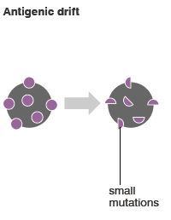
Orthomyxoviruses
Influenza viruses
• Unique aspects of its replication
- Genome replication
- Flu RdRp is very error prone
- Lots of point mutations are inserted
during genome replication
- Can lead to structurally different HA and NA proteins
emerging over time
- Called antigenic drift
- Assembly/exit
- Flu virions must package all of its 7-8 genomic fragments
- Missing any one → noninfectious
- Will often send a bunch to membrane (some get extra)

Slide 21
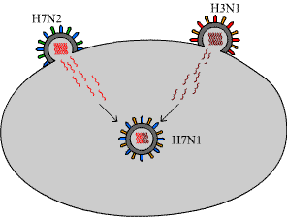
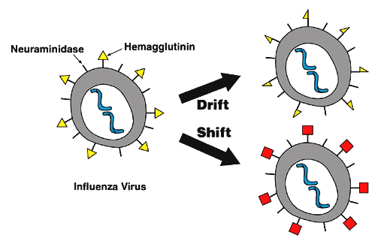
Orthomyxoviruses
Influenza viruses
• Unique aspects of its replication
- Antigenic shift
- Two different strains of flu can
infect the same cell
- More common in pig cells b/c
they have both types of SA-gal forms
- Both replicate their genomes
- When assembling, mixtures of
the two strains genomic
fragments can end up in a new
virion
- Can lead to major changes in strain type

Slide 22

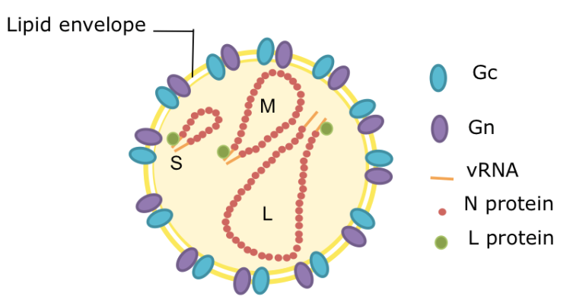
Bunyaviruses
Overview and diseases
• Huge family that contains over 300 unique viruses
- Most are arboviruses, but there are a few carried by
rodents (robovirus – rodent borne)
- Causes four different types of diseases in humans
- Encephalitis (e.g. La Crosse)
- Hemorrhagic fever
- Hemorrhagic fever + renal problems (Hantaan)
- Hemorrhagic fever + lung problems (Sin Nombre)
• Structural characteristics
- Three genomic pieces covered in N
protein (helical capsid)
- No matrix in the virion

Slide 23
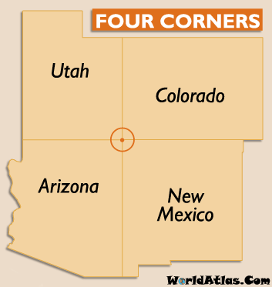
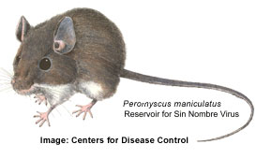
Bunyaviruses
Hantavirus (Sin Nombre)
• Sin Nombre virus is a type of Hantavirus (genus) that causes
a fatal hemorrhagic fever and respiratory failure
• First major outbreak occurred in the Four
Corners region of southwest U.S. in 1993
- 24 cases of hemorrhagic fever & pneumonia
amongst the Navajo and others
- 12 died
• Discovered to be spread by the inhalation
of dried deer mouse feces (after sweeping)
- Wet winters and increases in food let to
major increase in mouse population

Slide 24
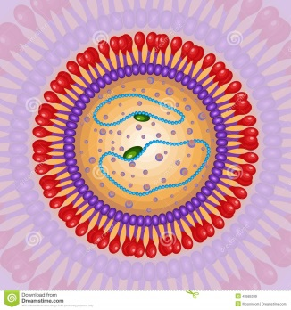
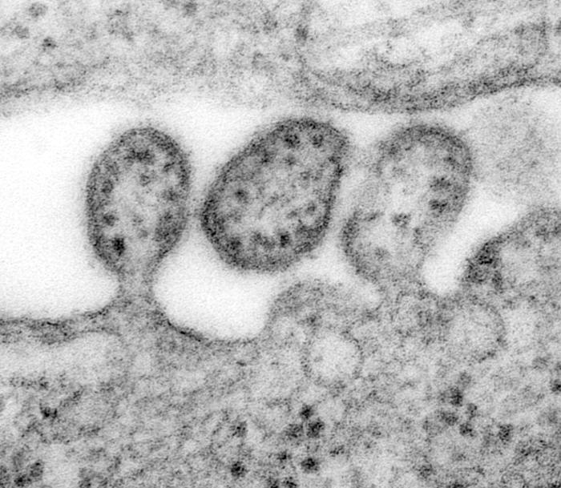
Arenaviruses
Overview
• Bipartite genomes w/in helical NC
surrounded by an enveloped
- Accidentally package host ribosomes
into virion particles - No known function
- Gives virion sandy appearance (arena= Latin for sand)
• Separated into Old World vs New World based on sequence
- Most are roboviruses (spread by rodent vectors)
• Causes a wide array of very serious diseases in humans
- LCMV – flu-like disease in mice, encephalitis in humans
- Lassa fever – hemorrhagic fever in W. Africa
- Several S. American hemorrhagic fever viruses

